Slide 1
Secure Data Hiding in Images Using Steganography
CAPSTONE PROJECT
Presented By:
Student Name : Mohit Tak
College Name : Lakshmi Naraine College of Technology
Department : Computer Science and Engineering

Slide 2
OUTLINE
Problem Statement
Technology used
Wow factor
End users
Result
Conclusion
Git-hub Link
Future scope

Slide 3
Problem Statement
In today's digital world, secure communication is crucial. Traditional encryption makes the presence of secret data obvious, making it vulnerable to attacks. Steganography helps hide information within images, ensuring data confidentiality without raising suspicion.

Slide 4
Technology used
Programming Languages: Python, Java
Libraries: OpenCV, PIL (Python Imaging Library), Stegano
Techniques: Least Significant Bit (LSB), Discrete Cosine Transform (DCT)
Operating System: Windows
System Requirements: 4gb RAM and latest software versions

Slide 5
Wow factors
Invisible Data Storage: The hidden message remains undetectable to the human eye.
Lossless Communication: Ensures minimal quality loss in the cover image.
Security Enhancement: Can be combined with cryptography for double protection.
Practical Applications: Used in military, digital watermarking, and covert messaging.

Slide 6
End users
Cybersecurity Professionals (for secure data transfer)
Journalists & Activists (to send confidential messages)
Forensic Experts (for watermarking & forensic analysis)
Government & Defense Organizations (for secret communication)

Slide 7
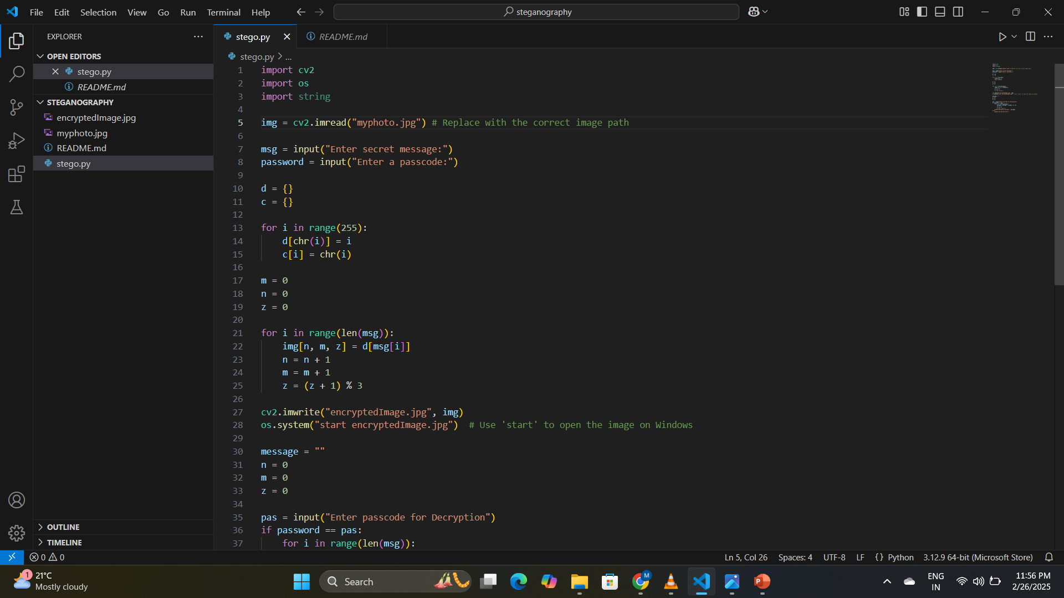
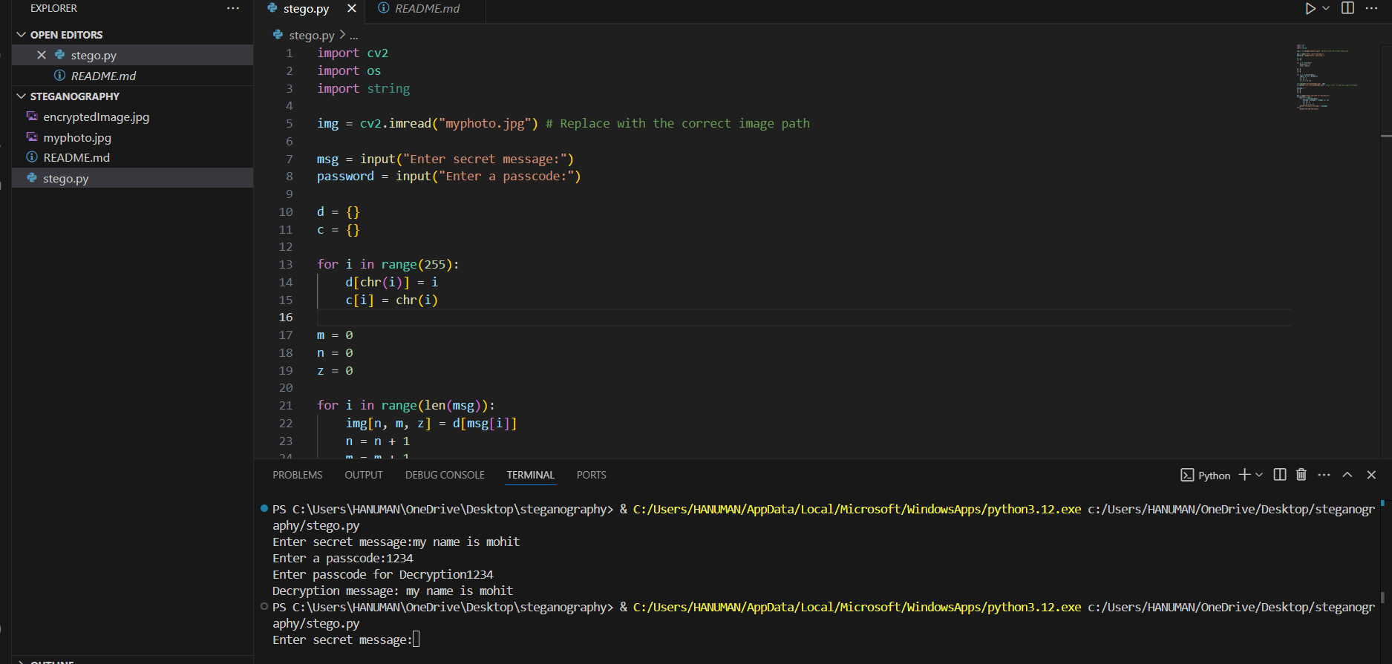



Results
Original
Encryped

Slide 8
Conclusion
Steganography is a powerful method for secure data transmission. Least Significant Bit (LSB) steganography is simple and effective for hiding data in images, but advanced techniques can enhance security. This technology plays a crucial role in cybersecurity, ensuring privacy and confidentiality.

Slide 9
GitHub Link
LINK - https://github.com/mohittak1811/Steganography.git

Slide 10
THANK YOU

